Slide 1
Comparative Analysis of Denoising Autoencoder and Convolutional Neural Networks for MNIST Classification
Presented by,
Bharath Muthuswamy Paran.

Slide 2
Research Question: How Do Denoising Autoencoders (DAE) and Convolutional Neural Networks (CNN) Compare in MNIST Digit Classification Under Varying Noise Conditions?
Why this research is important | Improves classification models' performance in noisy settings, vital for real-world applications like automated systems and medical imaging.
What we know and don’t know | We understand each model's strengths; however, their comparative efficiency under varied noise conditions remains less explored.
Our Experiment | Conducts a side-by-side comparison of two leading models under different noise levels to evaluate their accuracy and resilience.
Our Hypothesis | Predicts CNNs will outperform in lower noise, while DAEs will manage higher noise better but may falter with very high noise levels.

Slide 3
Design/Methods
Dataset | The MNIST dataset includes 70,000 images, providing a robust basis for evaluating the generalizability of the model results.
Data Collection | Data is directly sourced from the TensorFlow Libraries, ensuring consistency and reliability for model training and testing.
Data Analysis | Analysis includes exploring data distribution, variability, and typical characteristics of the MNIST dataset. Provides a baseline understanding that informs the design and calibration of neural network models.
Data Preprocessing | Identifies and removes any corrupt or incomplete data entries to improve model accuracy. Reshaping and scaling techniques applied to optimize data for efficient neural network training.

Slide 4
Design/ Methods
Data Normalization | Scales pixel values to a [0,1] range to facilitate faster convergence during model training and to prevent bias towards higher values.
Noise Generation for Various Noise Levels | Simulated real-world imperfections from low (0.05) to high (0.75) noise levels. Tested models' adaptability to progressively harsher environments.
Data Splitting | Divides the dataset into training, validation, and testing sets to ensure thorough evaluation and to mitigate overfitting.
Models | Convolutional Neural Networks (CNNs) Denoising Autoencoders (DAEs).

Slide 5
Design / Methods
Performance Evaluation | Uses metrics like accuracy, mean squared error, and confusion matrices to assess and compare the performance of the implemented models
DAE Image Reconstruction | DAEs effectively reconstruct images when exposed to low noise levels, maintaining a low mean squared error (MSE) which indicates high fidelity to the original image. High noise levels introduce complexities that DAE’s struggle to manage, resulting in less accurate reconstructions which may impact their utility in highly noisy environments.

Slide 6
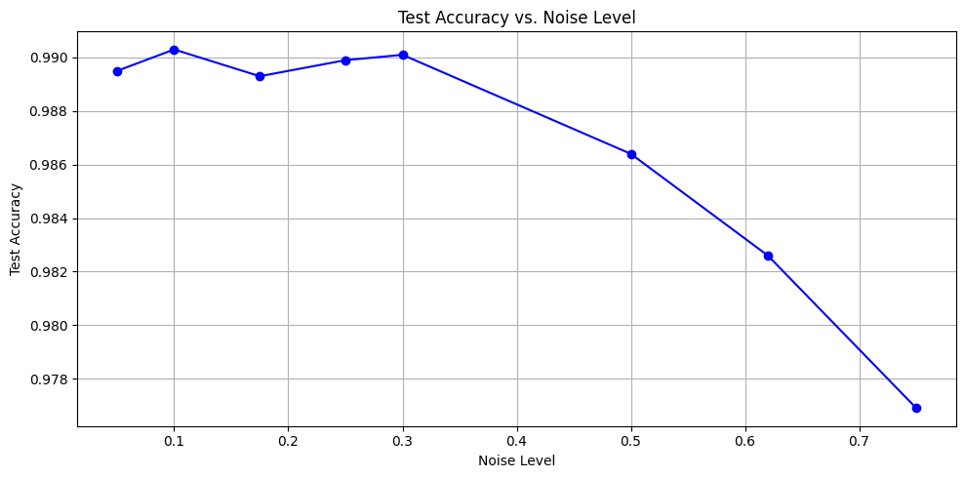
Data/ Results
Convolutional Neural Network
High accuracy maintained across noise levels:
Training (99.56% to 93.88%)
Validation (98.65% to 89.99%)
Testing (98.99% to 97.74%).
Slight performance dip at highest noise, indicating robust yet slightly declining resilience.

Slide 7
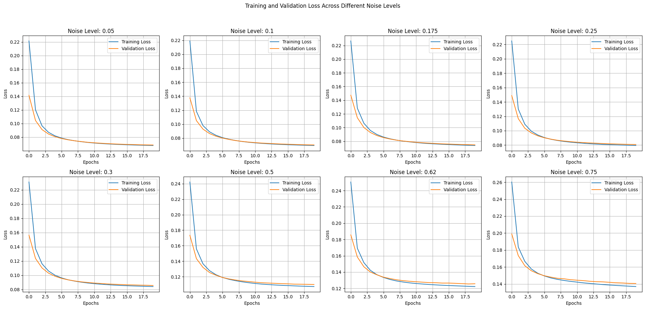
Data / Results
Denoising Autoencoder
Achieves low MSE rates (0.0021 to 0.0072) for noise levels up to 0.30, indicating strong initial denoising capabilities.
Maintains high classification accuracy, slightly tapering from 95.60% at noise level 0.05 to 95.16% at 0.30.
Significant increase in MSE and losses as noise levels rise, with MSE reaching 0.0249 at noise level 0.75.
Sharp decline in classification accuracy, dropping to 85.47% at noise level 0.75, highlighting challenges in severe noise conditions.

Slide 8
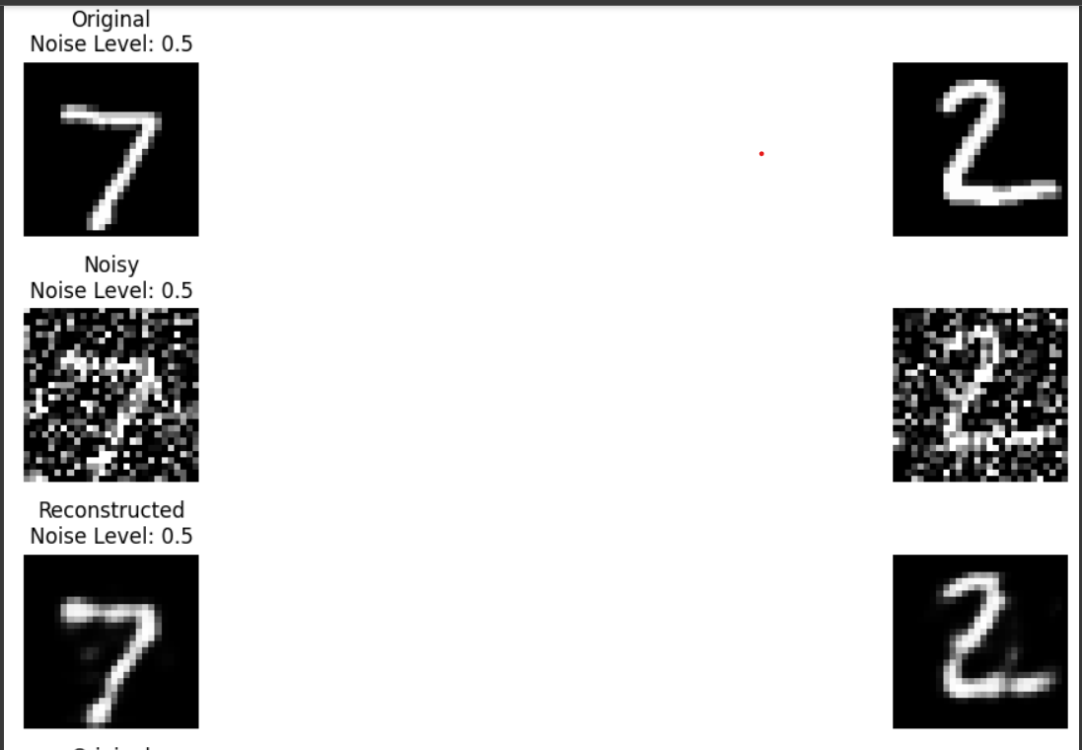
Data / Results

Slide 9
Conclusion
High Noise Resilience: CNNs demonstrate remarkable resilience against increasing noise levels, with only minimal reductions in performance. This resilience is indicative of their robust feature extraction capabilities which are less susceptible to noise. Sustained Accuracy: The sustained high accuracy in both training and testing phases suggests that CNNs are well-suited for environments where data quality may not be consistent, such as in real-time image recognition applications.
Strength in Low Noise: DAEs excel in environments with low to moderate noise levels, effectively reducing noise and reconstructing cleaner versions of inputs. This makes them suitable for applications where initial noise levels are controlled or moderate. Performance Drop in High Noise: As noise levels increase, DAEs struggle to maintain the quality of reconstruction, as indicated by rising MSE values. This degradation suggests a threshold beyond which DAE utility diminishes.

Slide 10
Next Steps
Enhancing DAEs: Investigate advanced techniques to improve DAE performance in high noise environments, such as integrating more complex noise models or using hybrid systems.
Robustness to Diverse Noises: Extend research to include other types of real-world noise, like salt-and-pepper or speckle noise, to further test model resilience.
CNN Adjustments: Explore deeper architectures or adaptive noise filtering layers to further boost CNN resistance to noise.
Hybrid Models: Develop combined CNN-DAE models to utilize CNN's classification strength and DAE's denoising capabilities, potentially offering the best of both worlds.
Data Augmentation: Utilize more sophisticated data augmentation strategies to simulate a broader range of noise impacts during training.
Algorithm Optimization: Employ newer optimization algorithms that may provide more robust convergence in noisy environments.

Slide 11

Questions?

Slide 12
Thank You

